Slide 1


GenViz Module 5: Variant annotation and interpretation
Malachi Griffith, Obi Griffith, Zachary Skidmore
Genomic Data Visualization and Interpretation
April 8-12, 2019
Freie Universität Berlin

Slide 2
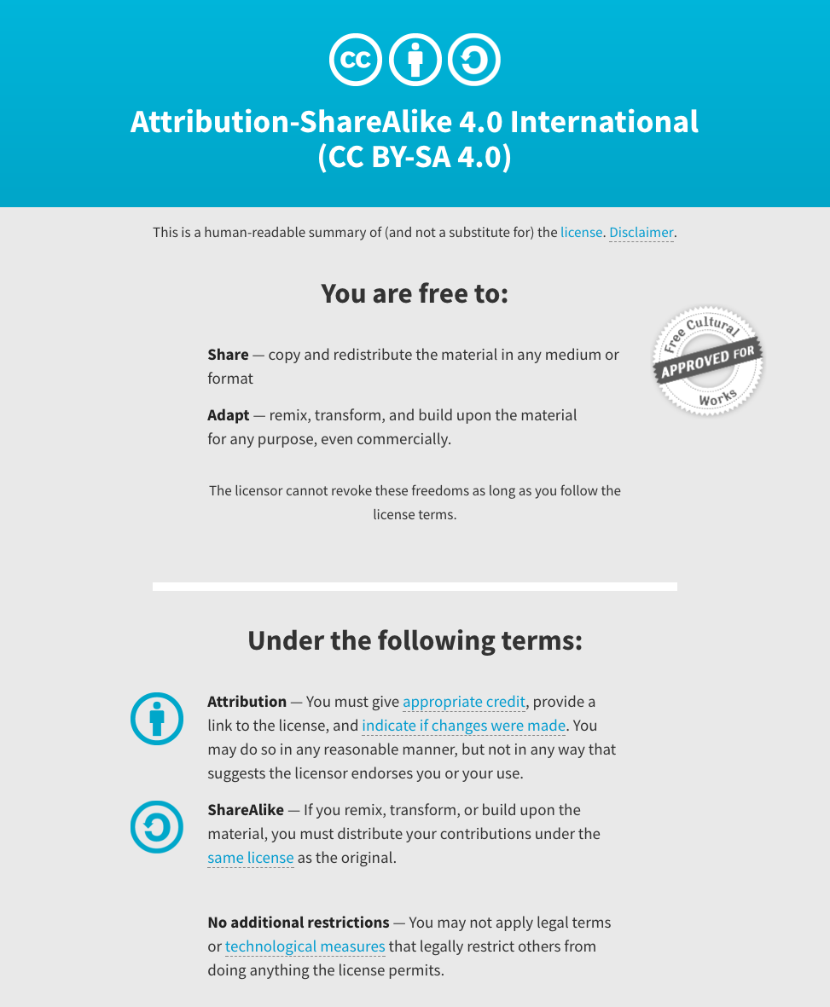
Notes:
Note there are two licenses if effect for this course.
All *content* (lectures, written materials, etc.) are made available under the Creative Commons Attribution-ShareAlike 4.0 International (CC BY-SA 4.0). (https://creativecommons.org/licenses/by-sa/4.0/).
All *code* (R scripts the website code itself) are made available under the MIT License (https://opensource.org/licenses/MIT).

Slide 3
Learning objectives of the course
Module 1: Introduction to genomic data visualization and interpretation
Module 2: Using R for genomic data visualization and interpretation
Module 3: Introduction to GenVisR
Module 4: Expression profiling, visualization, and interpretation
Module 5: Variant annotation and interpretation
Module 6: Q & A, discussion, integrated assignments, and working with your own data
Tutorials
Provide working examples of data visualization and interpretation
Self contained, self explanatory, portable

Slide 4
Learning objectives of module 5
Variant annotation and interpretation
Types of variation
Key concepts for interpreting variants
Variant resources
Human disease
Cancer
Non-human
Functional characterization
Clinical relevance

Slide 5
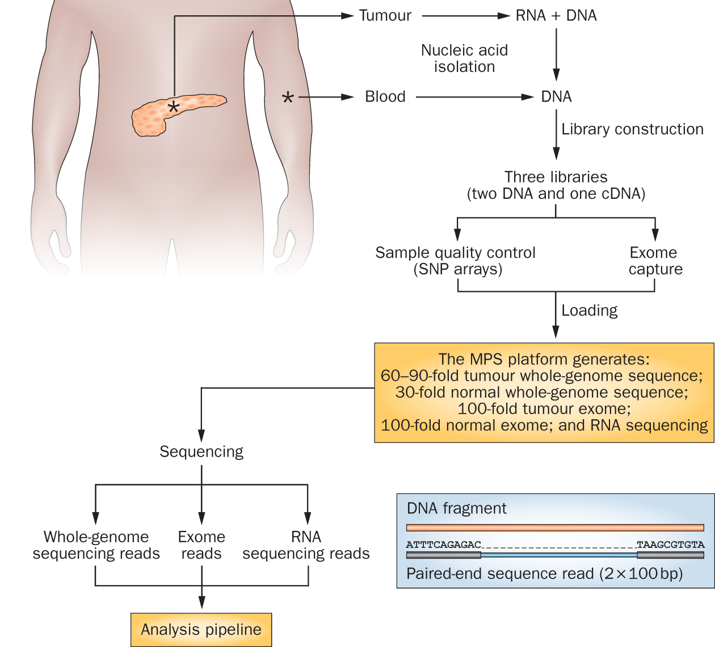
Cancer genomics research has exploded with the rapid advances in DNA sequencing technologies
Notes:
We sequence a lot of things at the Genome Institute. But my research interest is fairly focused on clinical cancer sequencing. The idea here is that we start with a patient, sometimes starting at diagnosis but often starting at the point where they have exhausted standard of care options.
From these patients we get a tumor sample and a reference normal sample (usually blood). From the tumor we isolate DNA and RNA and from the normal we isolated DNA. This trio of samples is subjected to library construction followed by whole genome, exome, and transcriptome sequencing. This data flows into our analysis systems and we attempt to detect somatic events that might be relevant to cancer biology or treatment. This involves detecting single nucleotide variants, small insertions and deletions, large copy number amplifications and deletions, gene and isoform expression levels, structure rearrangements, expressed gene fusions, and detection of tumor associated viruses.

Slide 6
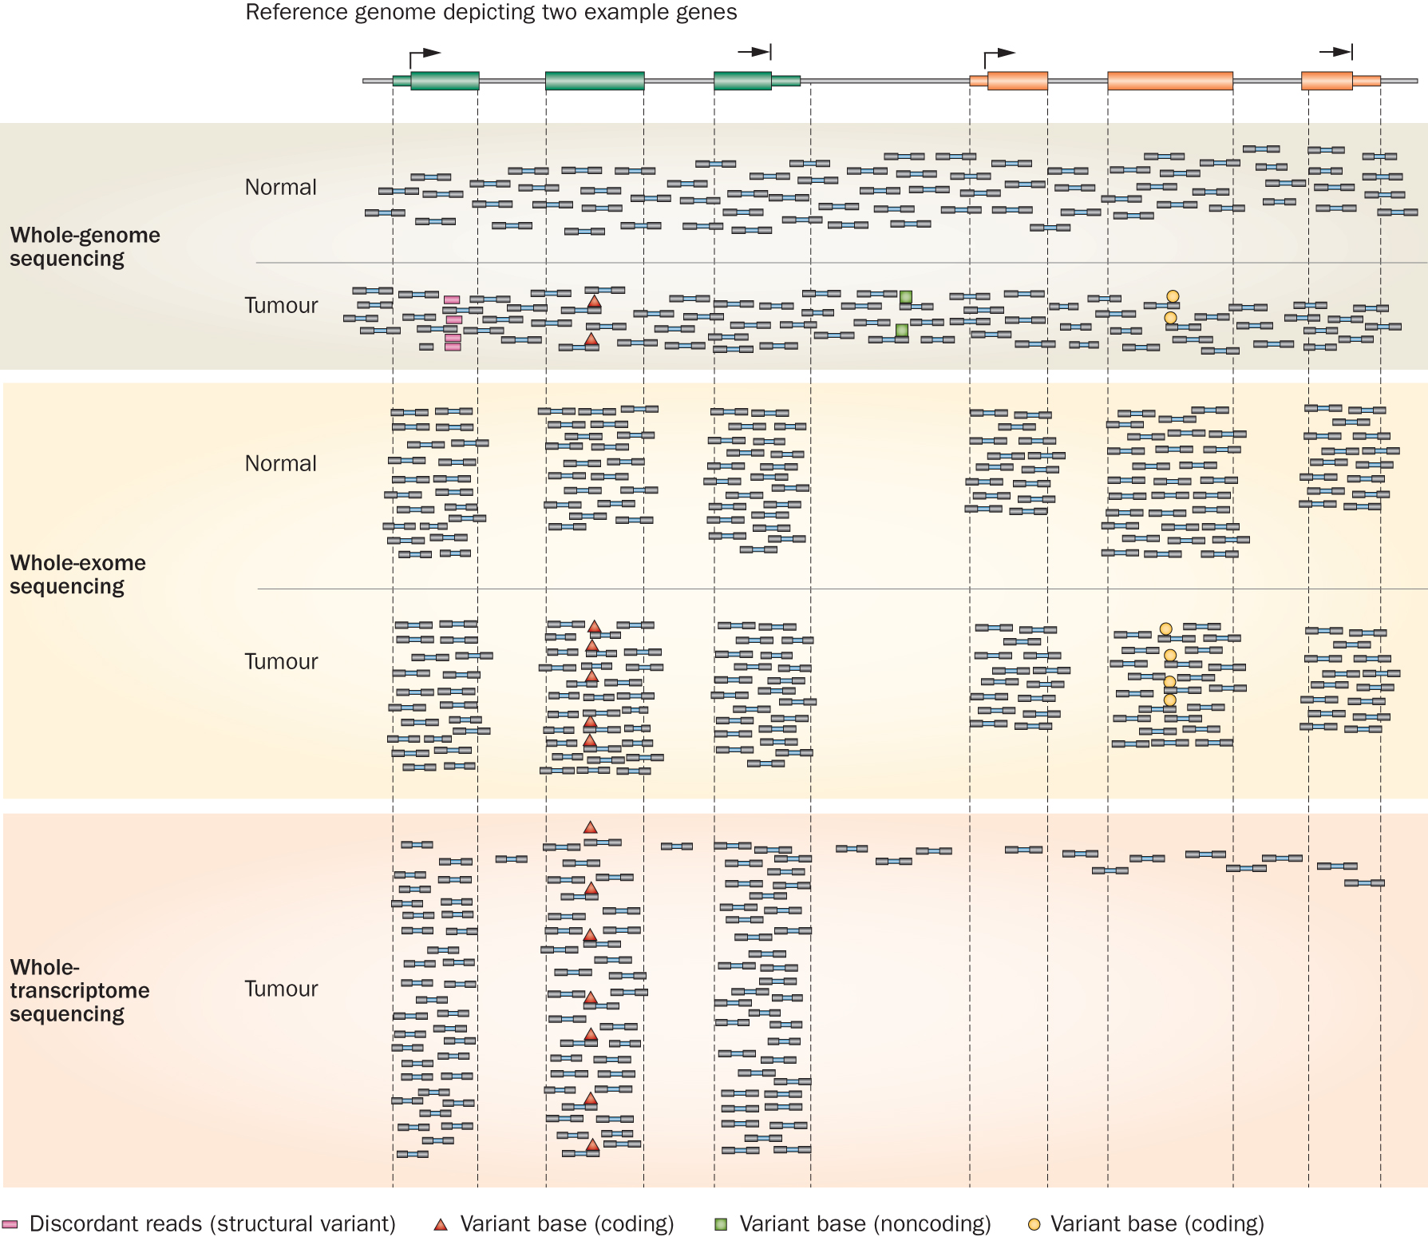
Whole genome, exome and transcriptome sequencing allows us to detect and confirm many different variant types
‘WGS’
‘Exome’
‘RNA-seq’
Notes:
Each of these three data types, whole genome, exome and transcriptome, brings something to the table.
Whole genome gives you broad, even, and relatively unbiased coverage across the genome.
Exome gives you more focused coverage but much greater depth over the exons for a much lower cost than whole genome
RNA-seq gives you a snapshot of the transcriptome.

Slide 7
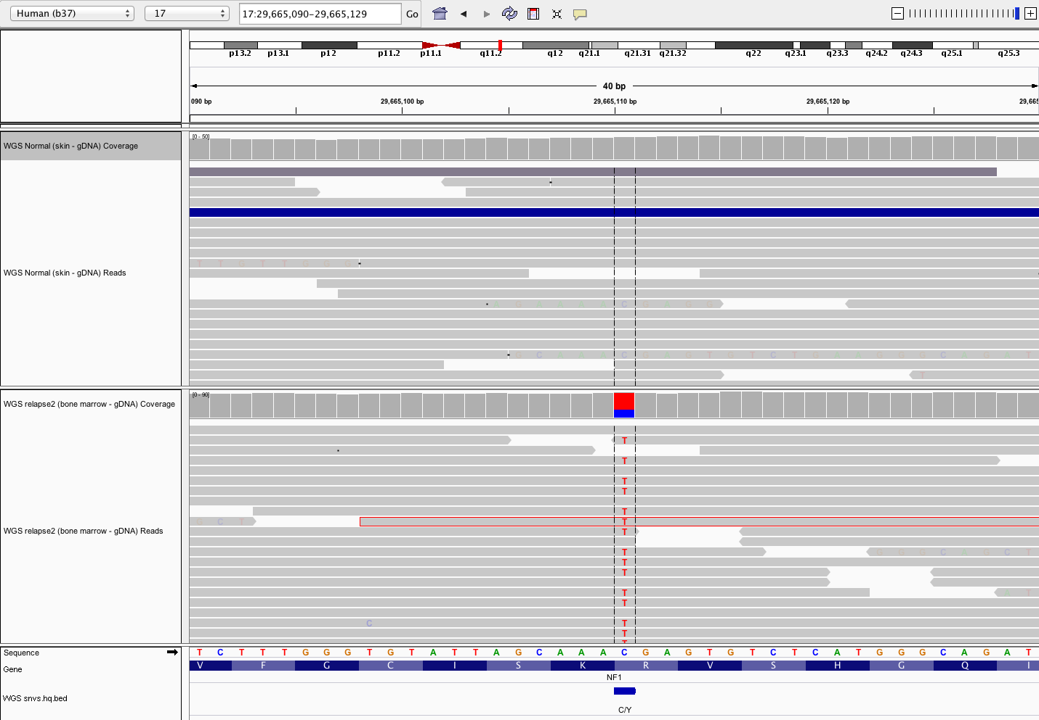
Single nucleotide variants (SNVs) and insertions/deletions (indels) appear as short alignment discrepancies from reference genome
Variant allele frequency
Normal
Single read
Tumor
Variant supporting read
Reference sequence
Amino acid
Notes:
This example SNV was detected in an ALL case
This is the simplest type of genomic event to detect, describe, annotate. Of course in this case the frequency is close to 50%. Suggesting a heterozygous mutation present in 100% of the tumor cells. If the tumor is impure, or heterogeneous, possibly with multiple sub-clones, or the normal is contaminated with tumor cells, calling even this simplest type of variants gets much harder.
We currently use four somatic SNV variant callers: SomaticSniper+Samtools, VarScan, Strelka, and Mutect

Slide 8
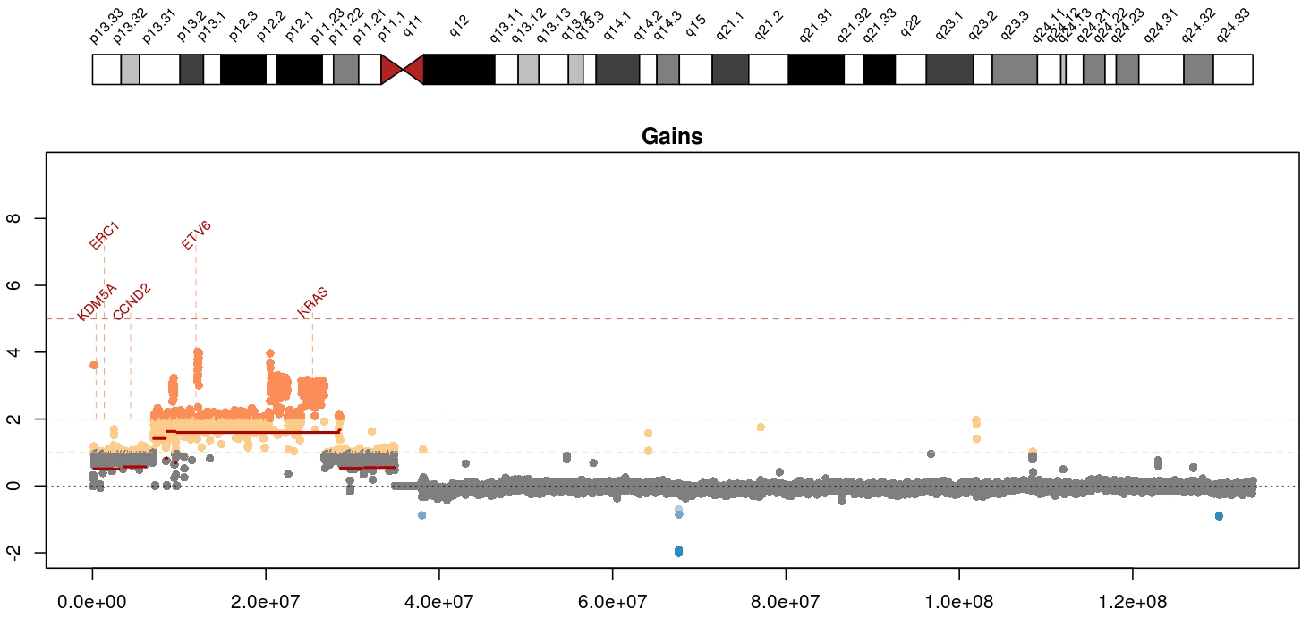
Copy number variants (CNVs) appear as deviations from in alignment “depth” or “coverage”
Mean tumor-normal depth per 10kb window plotted
KRAS amplification in a metastatic breast cancer
Notes:
Whole genome data is exceptionally good a detecting copy number alterations in tumors. You essentially get a beautiful digital karyotype for each tumor. Here we see a complex amplification affecting KRAS and ETV6 and other critical cancer genes by both single copy and two copy gains.
We currently use cnv-hmm, CopyCat, and CnView for this kind of copy number analysis

Slide 9
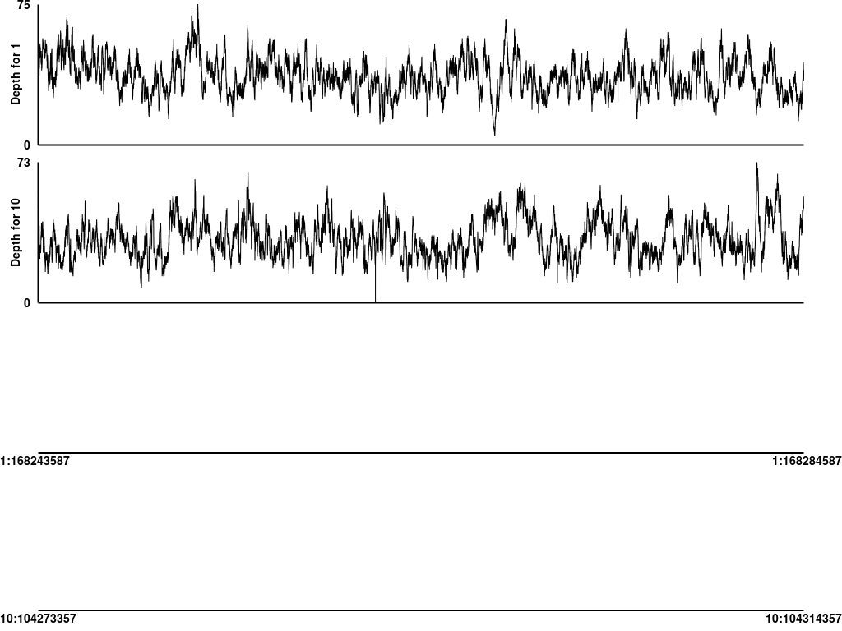
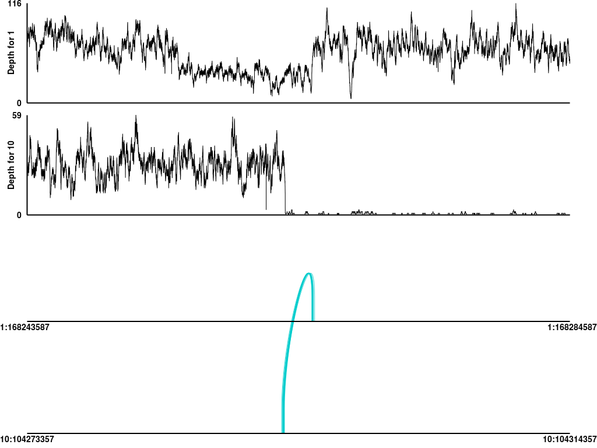
Structural variants (SVs) can be identified using a combination of coverage and discordant read alignments
Normal
Tumor
Coverage
Coverage
Chr1
Chr10
Chr1
Chr10
Discordant read support
Discordant read support
A Chr1-Chr10 (TBX19-SUFU) unbalanced translocation identified in an adult acute lymphocytic leukemia.
Notes:
Detected in an ALL case. One of the more difficult even types to predict are structural variants such as the interchromosomal translocation show here. Discordant read pairs, coverage patterns, and reads aligning across a junction breakpoint supporting a translocation involving chr1 and chr10 in this tumor. It is clearly somatic and not observed in the normal. While we can identify such events readily they are generally buried in a large pile of false positives. We also fear a large number of false negatives (but we have difficulty estimating this).
We currently use a combination of BreakDancer, SquareDancer, and Tigra-SV in our SV pipeline. We are in the process of incorporating lumpy-sv.

Slide 10
Expressed gene fusions can be identified by discordant read alignments spanning known exons from RNA-seq data
EP300-ZNF384
Encompassing (70)
RNA-seq read support
Spanning (258)
7
8
7
7
7
7
8
7
6
5
8
7
8
7
6
7
8
6
5
9
ZNF384 (NM_133476.4)
EP300 (NM_001429.3)
Slide from Chris Maher and Jin Zhang
12p13.31
22q13.2
Exons 1-8 of EP300 fused to exons 7-10 of ZNF384 in head-to-tail fashion.
Notes:
Here we have an expressed gene fusion detected by RNA-seq detected in an ALL case.
These events are detected by mining RNA-seq alignments for cases where both encompassing (or discordant) read pairs and fusion junction spanning reads support a geneA to geneB fusion.
As with detecting structural variants in the DNA data we know that overall we are not doing a great job of identifying these things. The current state of software packages for these events leaves a lot to be desired. We use ChimeraScan and Integrate. But we have also evaluated tophat-fusion, defuse, and others.

Slide 11
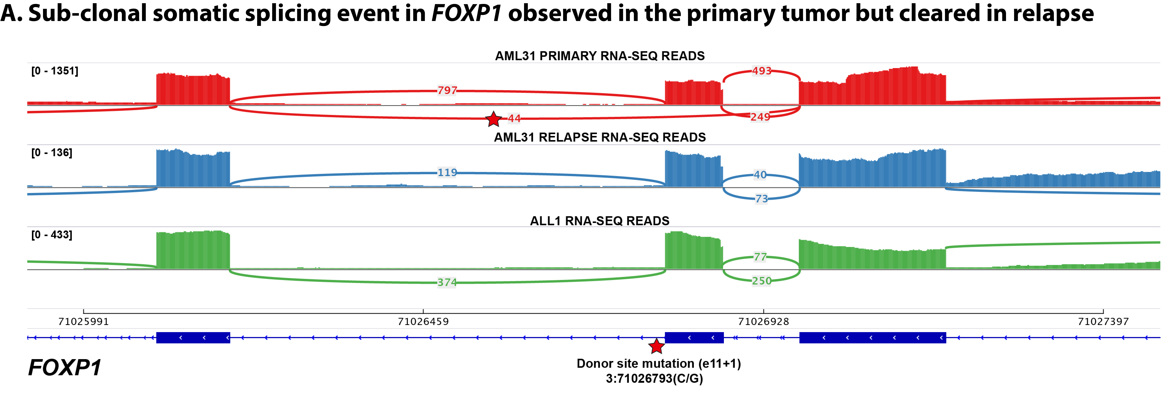
RNA-seq can also reveal the splicing consequence of somatic mutations detected in WGS
Splice site mutation
Read alignments support the skipping of affected exon
We created ‘RegTools’ to help characterize these kinds of events
Notes:
By integrating whole genome and transcriptome data we can start to test hypothesis for the splicing or regulatory effect of variants beyond those that are predicted to result in a direct amino acid substitution.
For example, in this AML case we found a somatic mutation near a splice donor site in a relapse tumor sample. In the RNA-seq data for this sample we see corresponding skipping of the affected exon. We do not see this exon skipping in other samples that lack the mutation.
We are currently working on tools to automate this type of analysis.

Slide 12
Tumor genome analysis will typically reveal dozens to thousands of alterations of multiple types
SNVs
SVs
Indels
CNVs
Gene expression
Notes:
From an end users perspective what you get out of the GMS is summarized results and visualizations that help you interpret and mining NGS data
The following slides show some examples of each of these types of predictions. They are listed in order from most developed and reliable to least developed and most experimental

Slide 13
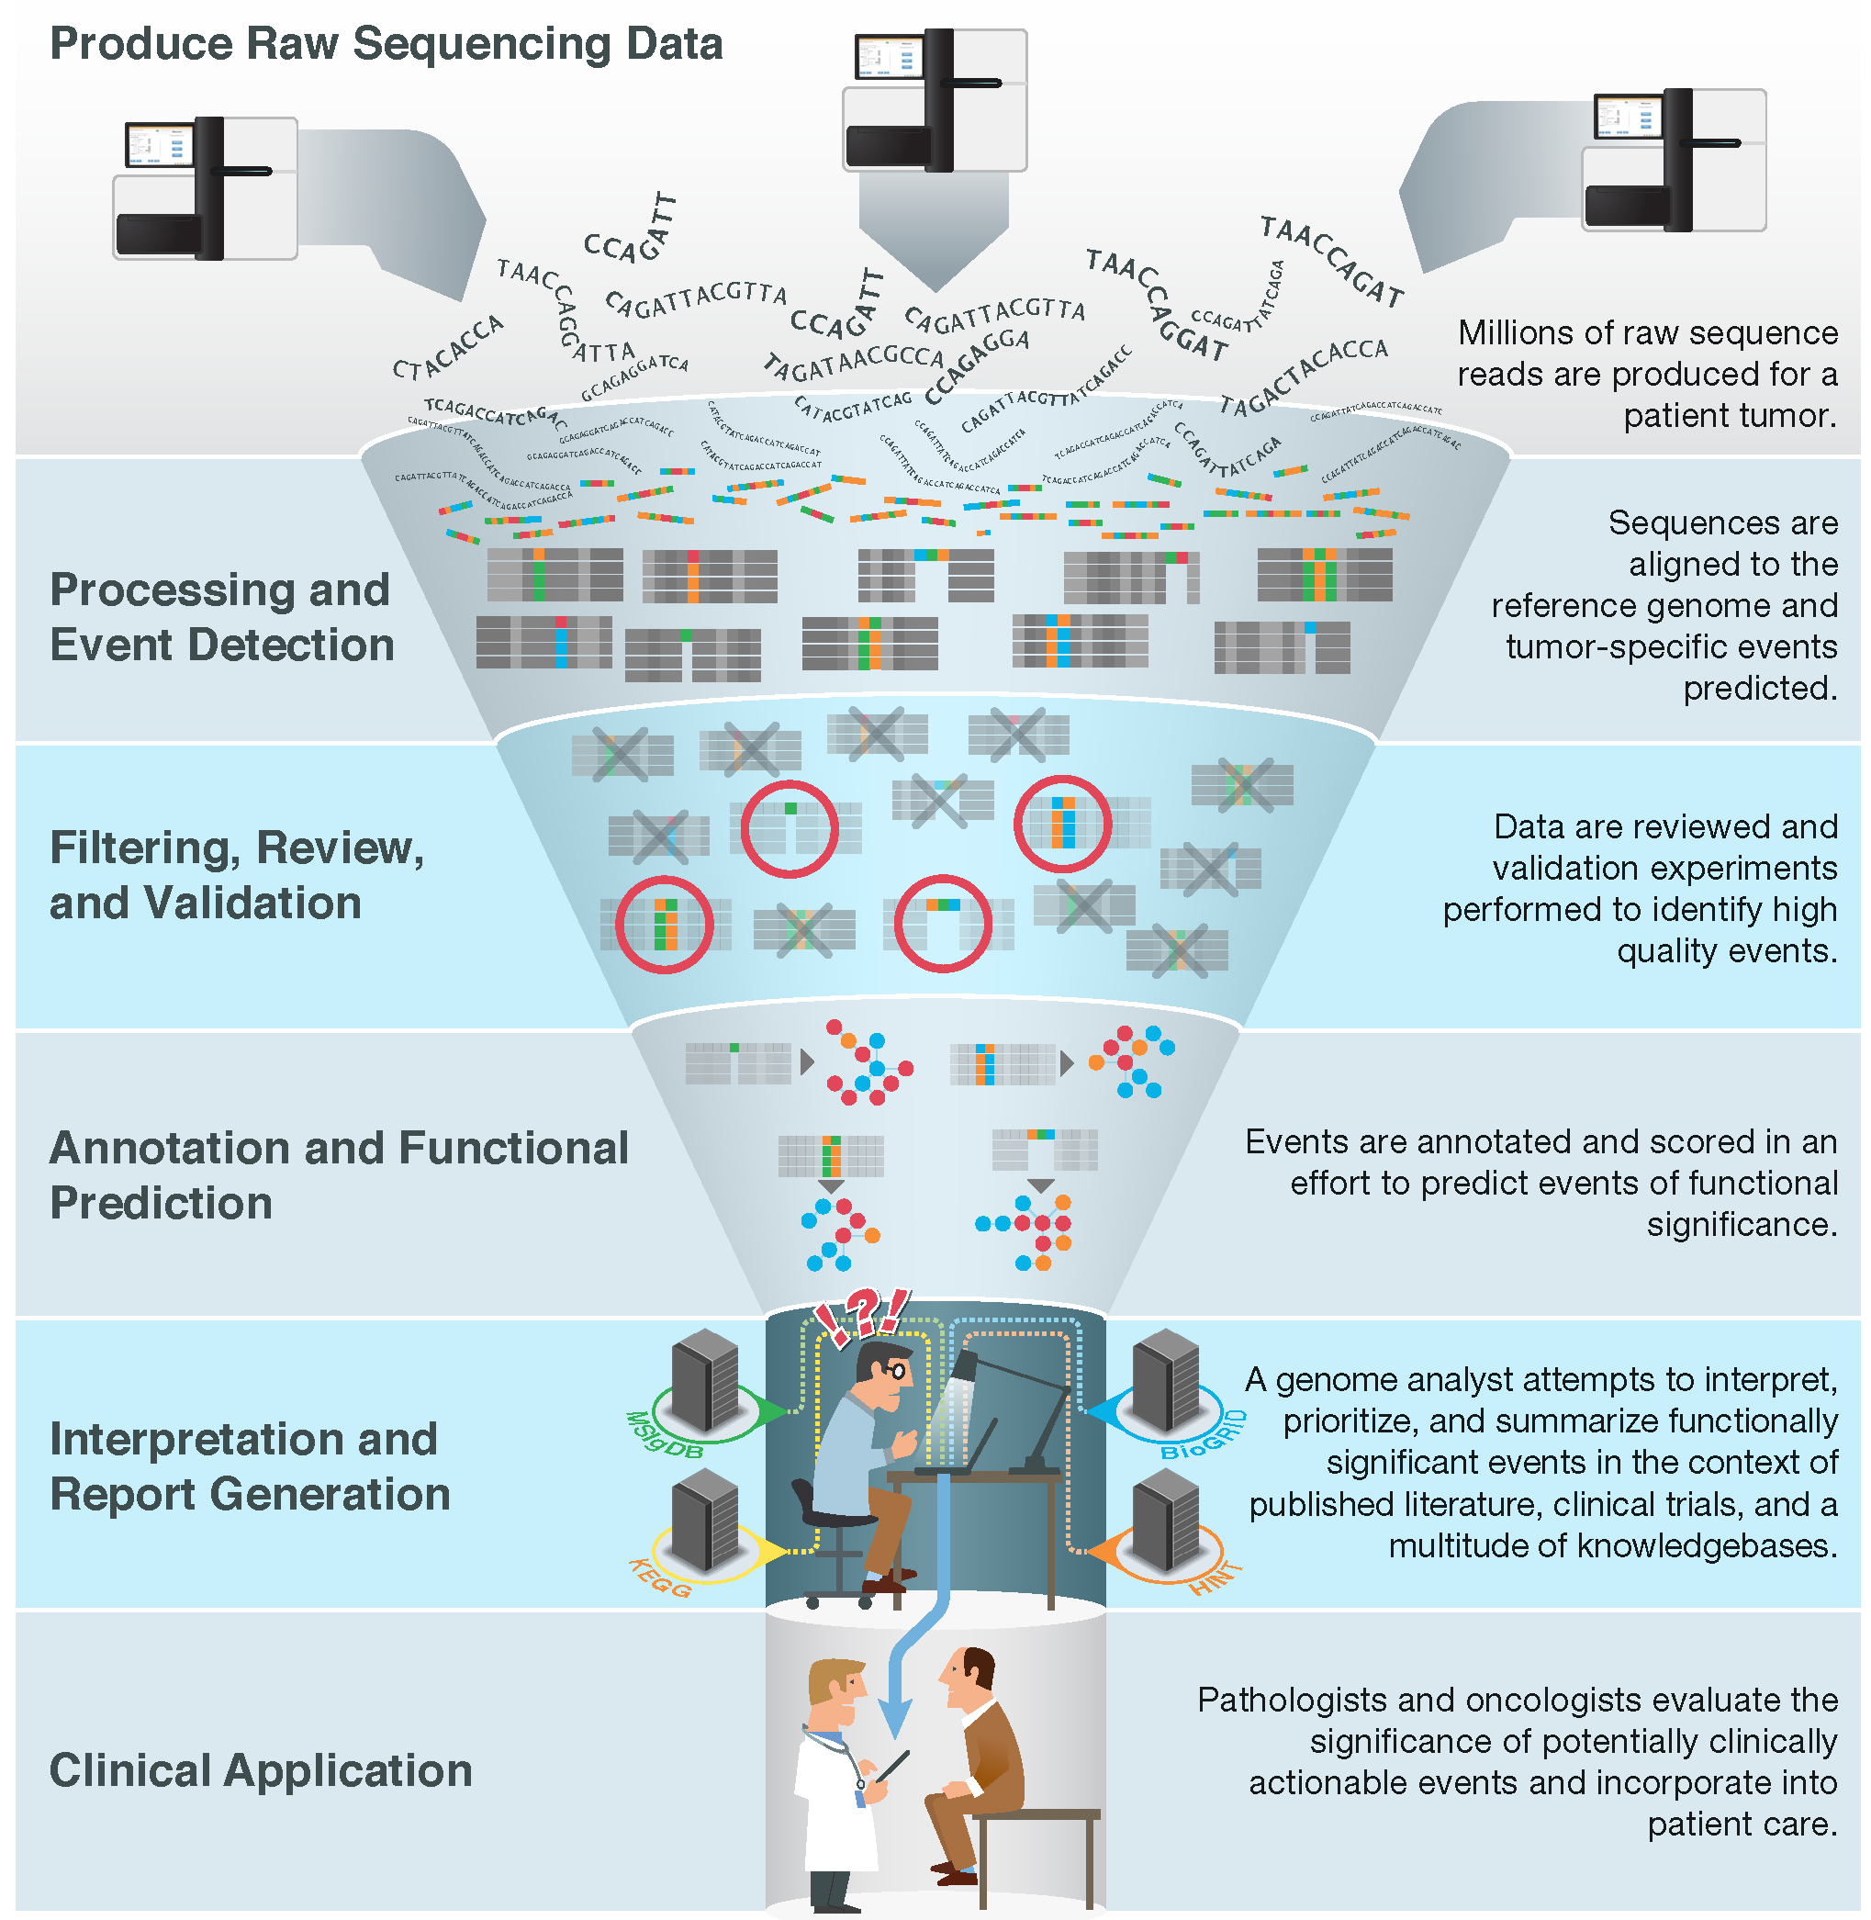
Despite remaining challenges, most aspects of sequencing and analysis have been standardized and streamlined
Good BM, Ainscough BJ, McMichael JF, Su AI†, Griffith OL†. 2014. Genome Biology. 15(8):438.
Notes:
We have an embarrassment of riches with all of the –omic events now being detected (though there is plenty of room for improvement!).
We are starting to have a handle on doing this routinely and quickly. We can generate the raw data, feed it into automated pipelines that process the data and predict genomic events. Filtering, review and validation thins these lists down to somewhat tractable counts of 10s to 100s of events. Where we are really stuck now is at the interpretation and report generation stage. This is a major bottleneck. The ‘genome analysts’ who have the skill sets to assemble final reports that a clinician might find useful are completely swamped.
One way to address this I already talked about. Education. We can train more of these genomics experts. But we also need to harness informatics strategies to make their job easier and address the bottleneck. With that in mind we are pursuing various data mining, crowd sourcing, natural language processing, etc.

Slide 14
Interpretation of genomic alterations in the context of the clinical relevance remains the major bottleneck
Good BM, Ainscough BJ, McMichael JF, Su AI†, Griffith OL†. 2014. Genome Biology. 15(8):438.
Notes:
We have an embarrassment of riches with all of the –omic events now being detected (though there is plenty of room for improvement!).
We are starting to have a handle on doing this routinely and quickly. We can generate the raw data, feed it into automated pipelines that process the data and predict genomic events. Filtering, review and validation thins these lists down to somewhat tractable counts of 10s to 100s of events. Where we are really stuck now is at the interpretation and report generation stage. This is a major bottleneck. The ‘genome analysts’ who have the skill sets to assemble final reports that a clinician might find useful are completely swamped.
One way to address this I already talked about. Education. We can train more of these genomics experts. But we also need to harness informatics strategies to make their job easier and address the bottleneck. With that in mind we are pursuing various data mining, crowd sourcing, natural language processing, etc.

Slide 15
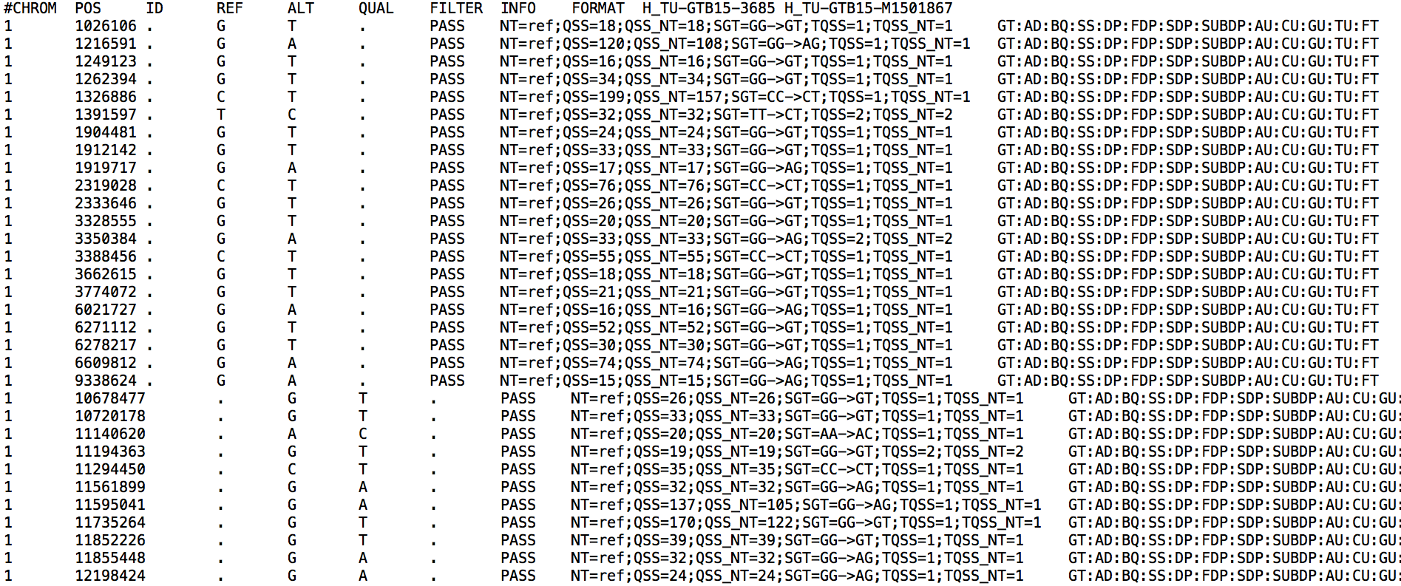
Variant analysis/interpretation starts with a raw variant list (VCF file)
Details of the VCF file format: hts-specs, VCF-v4.2.pdf

Slide 16
How do we interpret these variants?

Slide 17
Important concepts in the interpretation of variants
False positives vs. true positives
Somatic mutation vs. germline mutation vs. germline polymorphism
Gain-of-function (activating) vs. loss-of-function (inactivating)
Deleterious vs. tolerated
Recurrent vs. random
Driver vs. passenger
Dominant clone vs. sub-clonal
Regulatory vs. coding
Relevant to cancer biology
‘canonical’ variants, ‘hotspot’ variants, ‘cancer genes’
Clinically relevant / ‘actionable’
‘Druggable’
Predictive, prognostic, diagnostic, predisposing
Notes:
Many of these terms are often used in

Slide 18
Somatic mutation vs. germline mutation vs. germline polymorphism
Somatic mutations are best distinguished by adequate sequencing of a matched normal
Affected and unaffected family members may help to determine origin of a germline mutation
Comparison of variants to variant databases can also help to classify variants as:
Germline polymorphisms
1000 genomes
Exome sequencing project (~6,500 individuals)
ExAC, Exome Aggregation Consortium (~60,000 individuals)
gnomAD browser (123,136 WXS and 15,496 WGS)
Germline mutations
OMIM, HGMD, PharmGKB, ClinVar
ACMG guidelines
Gemini
Somatic mutations
By inference if the mutation is not a common polymorphism (often a weak inference) or is a classic hotspot mutation

Slide 19
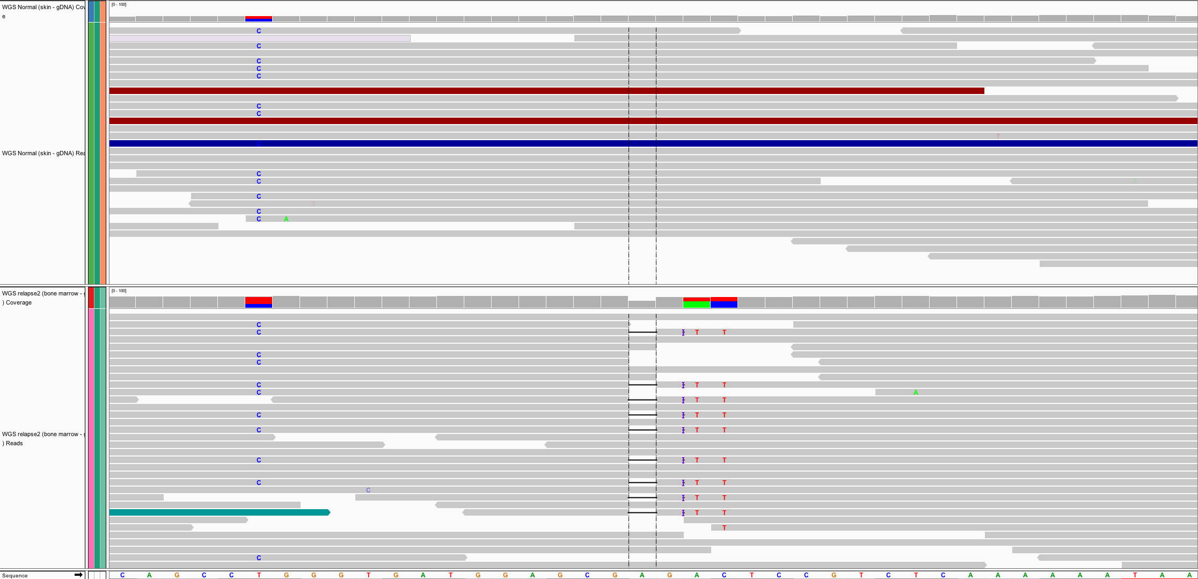
Somatic versus germline demonstration
Germline mutations
Present in egg or sperm
All cells of affected offspring
Heritable
Cause of familial cancers
Somatic mutations
Occur in non-germline tissues
Only tumor cells (breast, lung, blood, etc.)
Non-heritable
Cause of sporadic cancers
Normal
Tumor
Germline
Somatic

Slide 20
False positives
Use IGV to examine alignments for artifacts
Use an intersection of variant callers
“panel of normals” analysis
Useful resources
Discussion of variant callers
Optimizing tumor genome analysis
Hands-on IGV tutorial

Slide 21
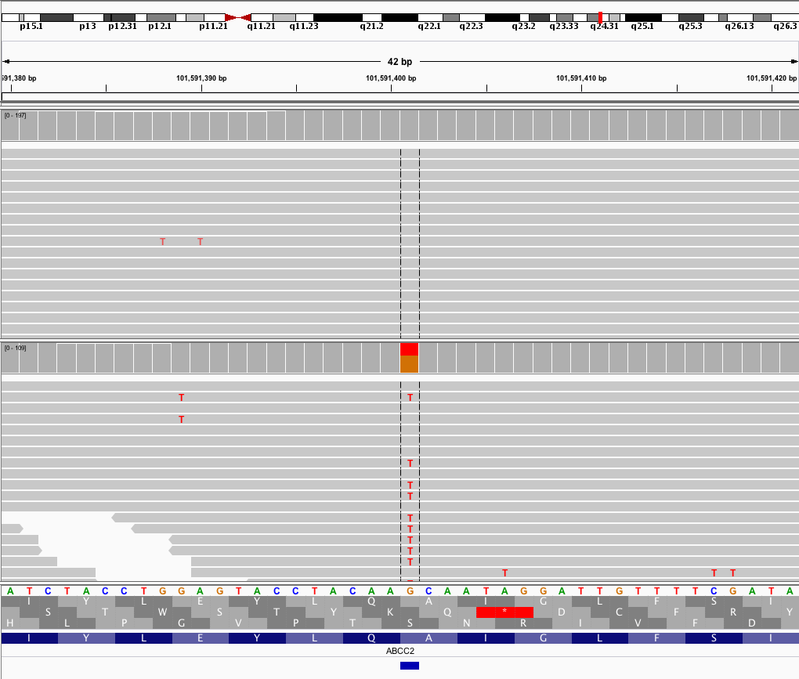
Example of a high quality somatic variant
Normal
Tumor
This G/T variant was independently called by 5 somatic variant callers

Slide 22
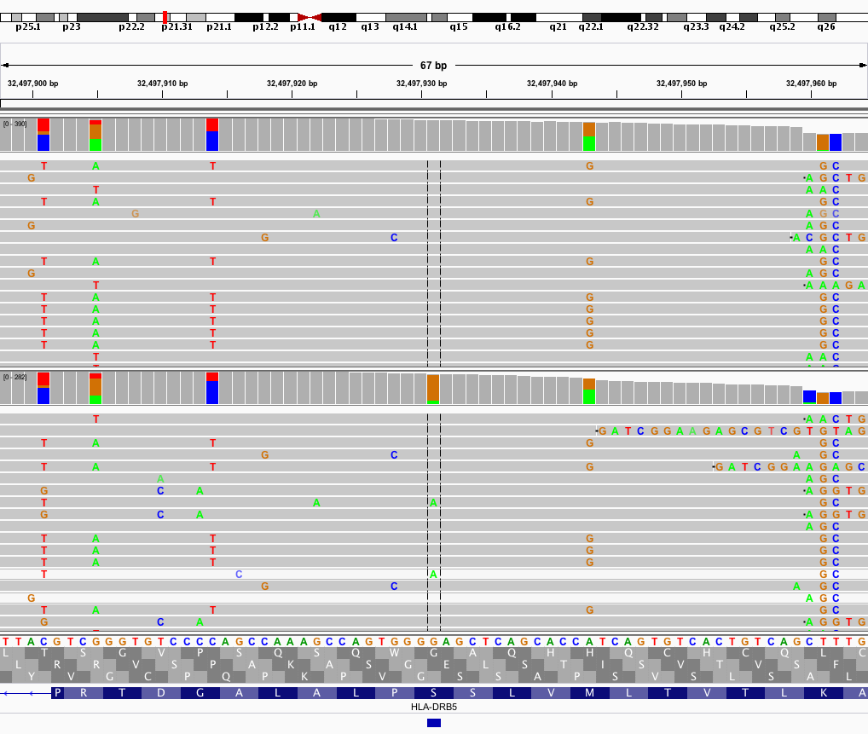
Example of a low quality somatic variant
Normal
Tumor
This G/A variant was called by only 1 of 5 somatic variant callers

Slide 23
Variant allele frequency (VAF)
VAF = Variant reads / Total reads
Normal
VAF = 0/20 = 0%
Tumor
VAF = 14/20 = 70%
A heterozygous variant is expected to have VAF = 50%. Often not true due to sample purity, tumor heterogeneity, sampling error, alignment issues, copy number variation, etc.

Slide 24
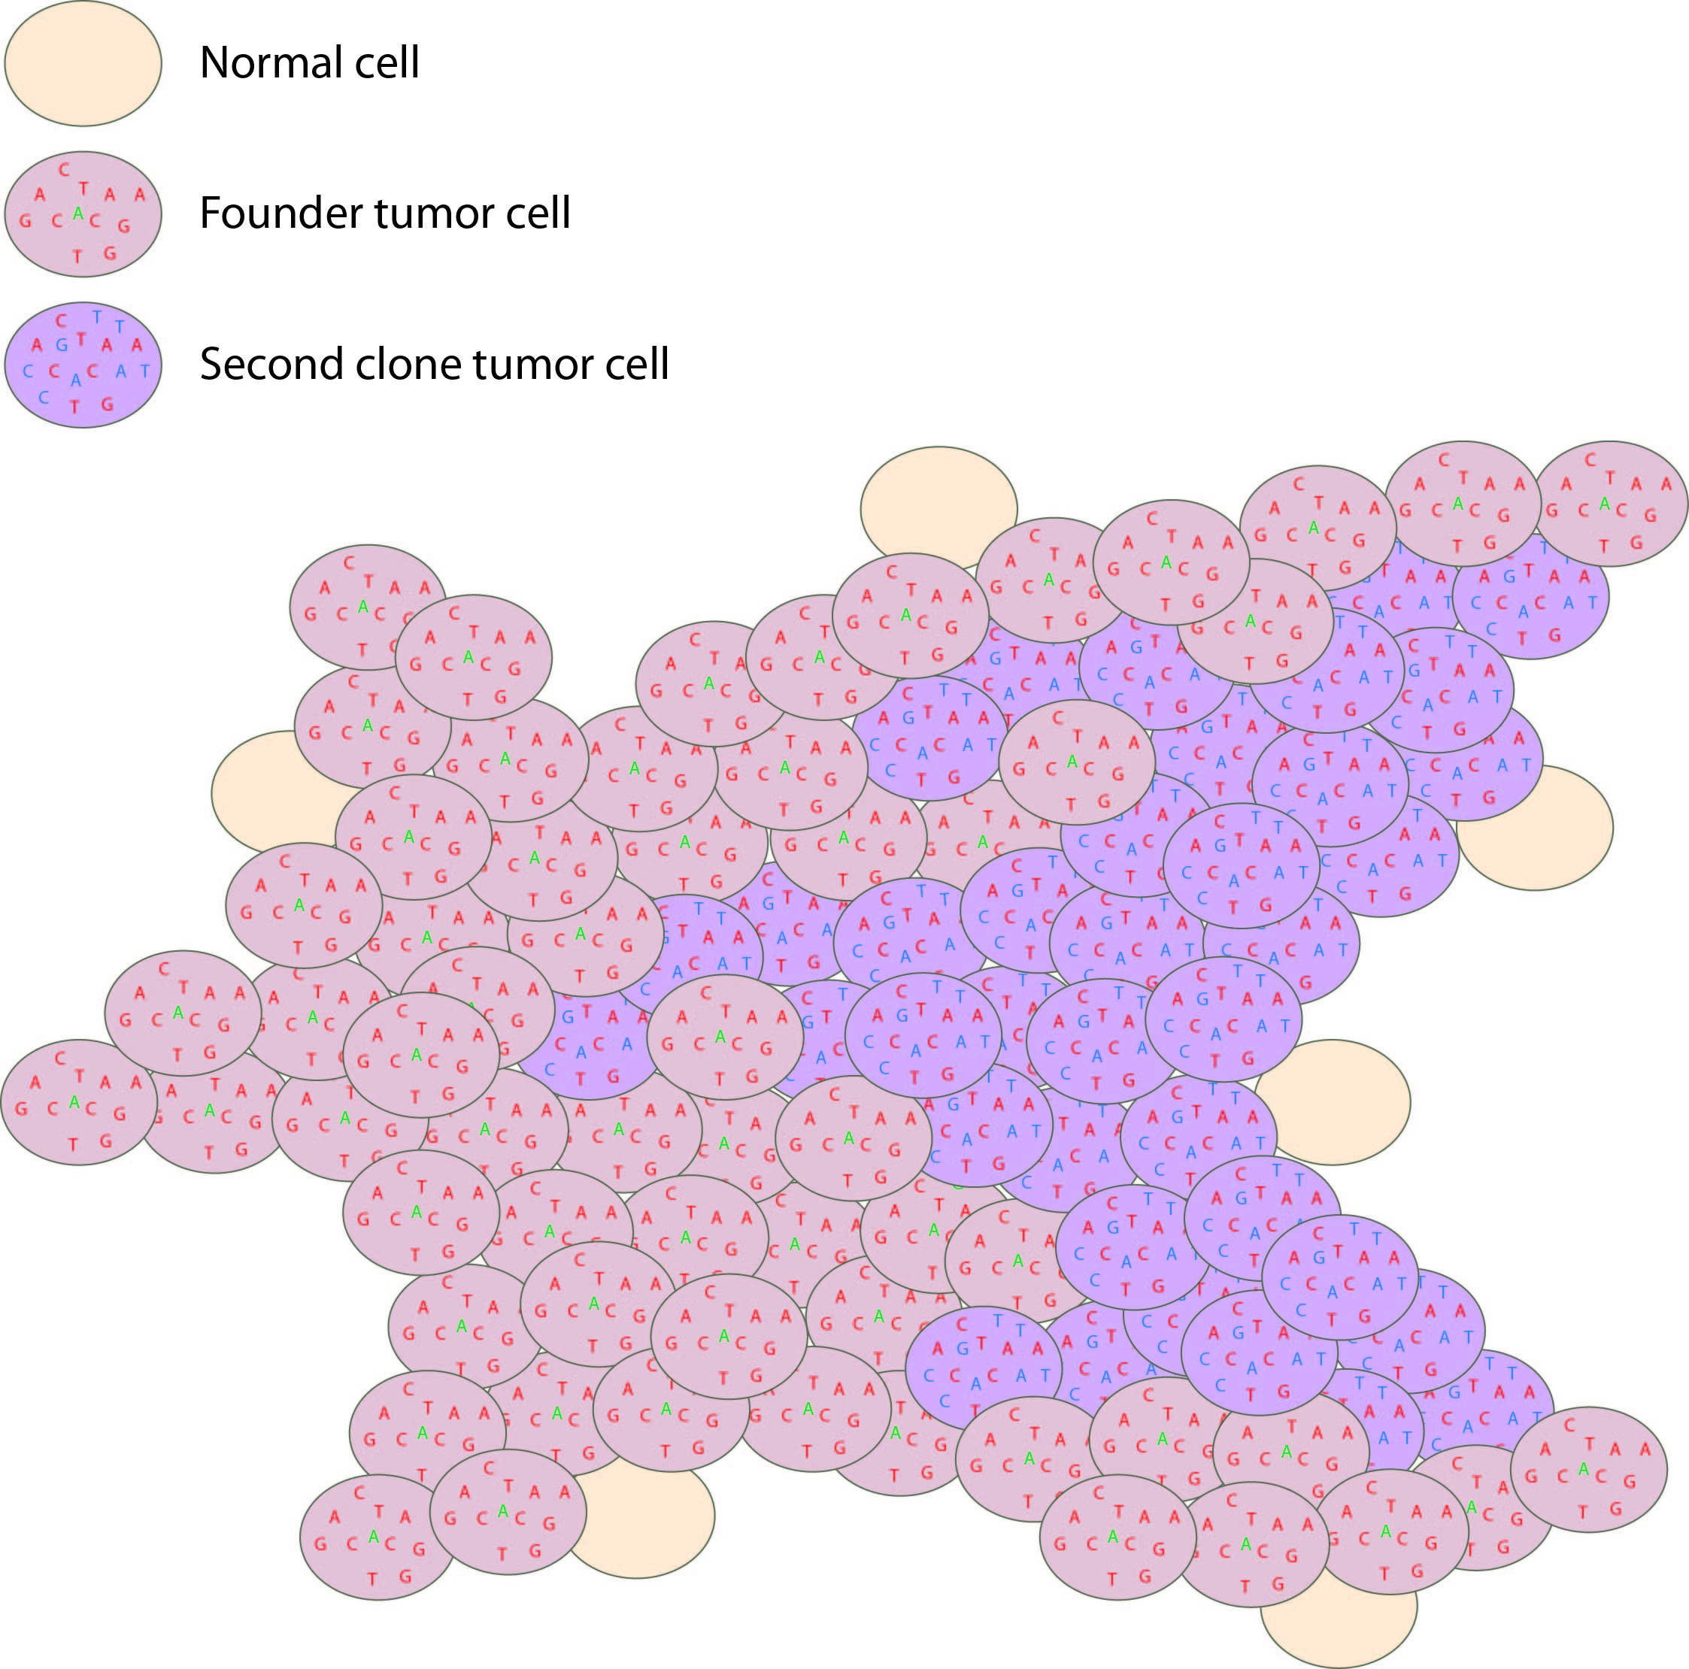
Dominant clone vs. sub-clonal (and driver vs. passenger)
Tumor variant allele frequency
Proportion
NF1
Read coverage (X)
WGS data
Tumor variant allele frequency
Tumor variant allele frequency

Slide 25
Gain-of-function vs. Loss-of-function
Gain-of-function and loss-of-function generally refer to a change in specific function of a gene product (protein or RNA) leading to a phenotypic effect
Loss-of-function implies that a normal gene function is no longer possible
Many random mutations can lead to inactivation
Manifests in mutation data as scattered across the length of the gene and may be frameshift, nonsense, and splice site mutations
Gain-of-function implies an increased or new gene function
There are far fewer ways to create an activating mutation
These tend to have dominant phenotypes
Manifest in mutation data as “hotspots”
Usually missense mutations
The pattern of *recurrence* can be a powerful hint for distinguishing activating vs. inactivating mutations.

Slide 26
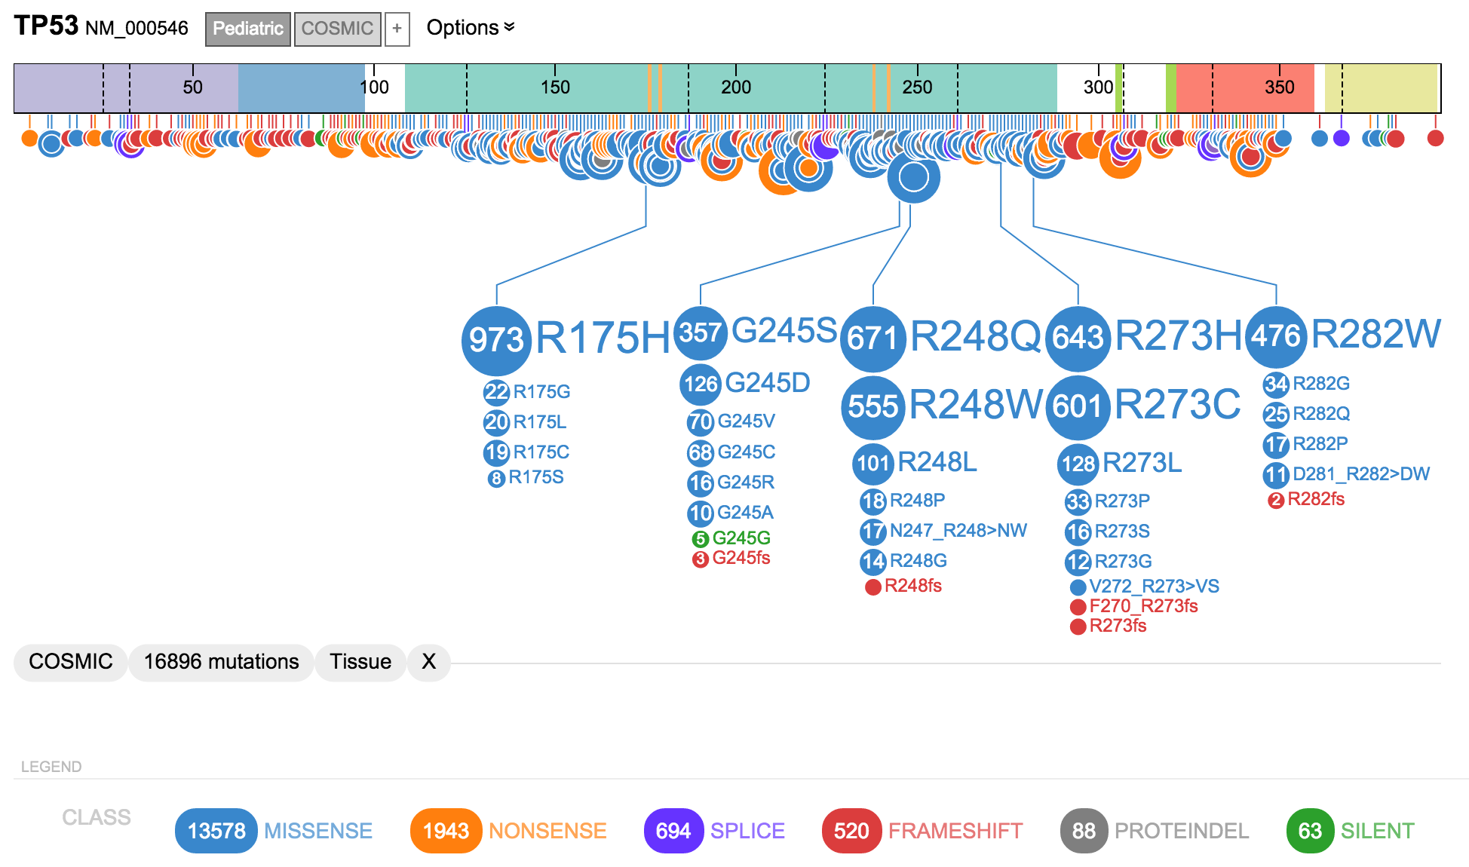
Gain-of-function vs. Loss-of-function
TP53: Recurrence pattern and mutation types suggest loss-of-function

Slide 27
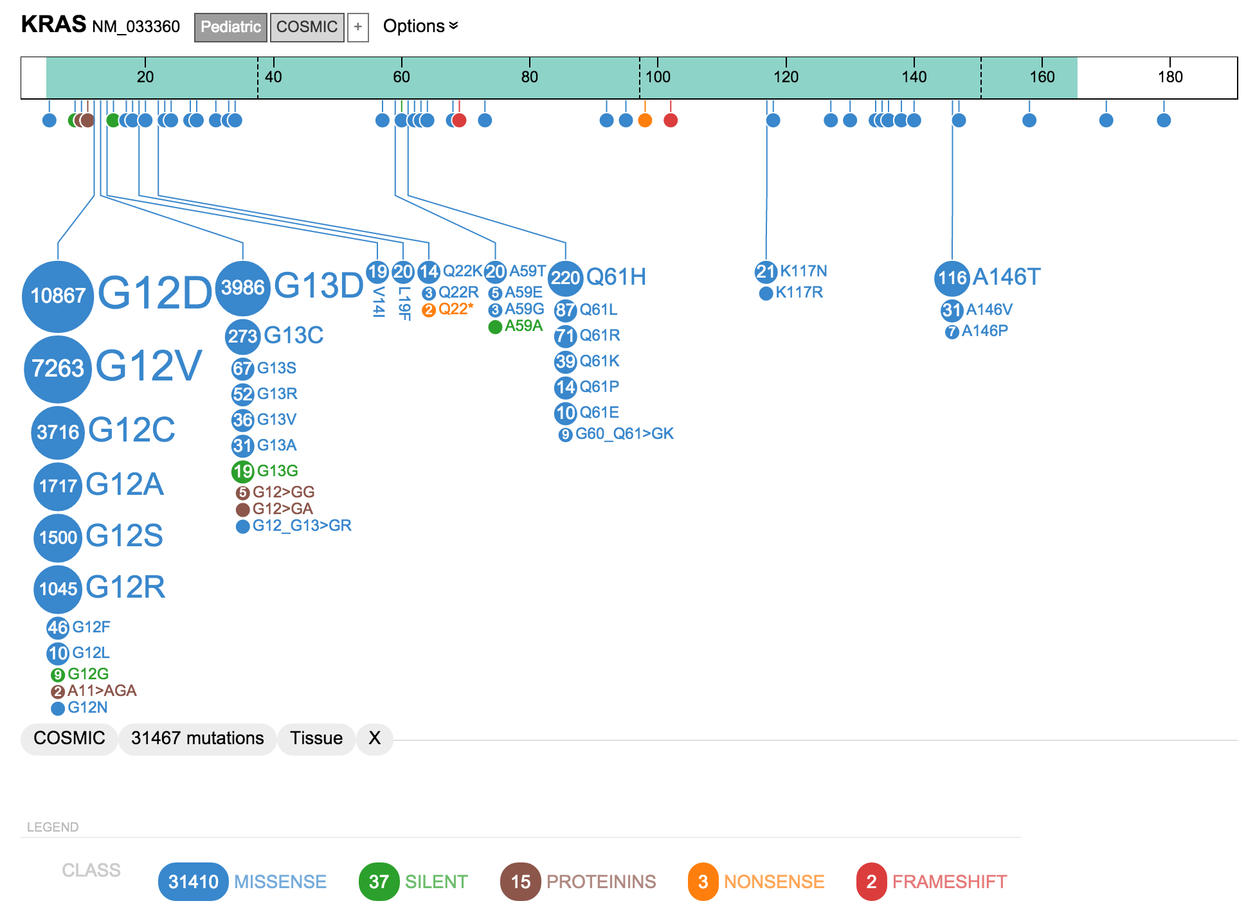
Gain-of-function vs. Loss-of-function
KRAS: Recurrence pattern and mutation types suggest gain-of-function

Slide 28
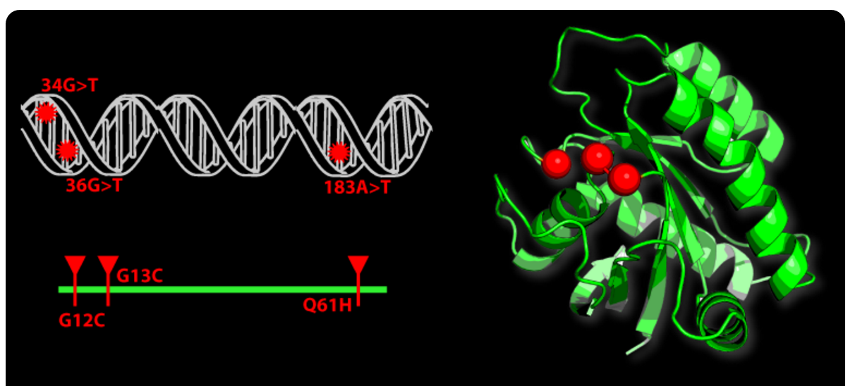
Gain-of-function “hotspots” may be missed in 2D but seen in 3D models of protein structure
From: Mutation3D website.
For a more detailed discussion of relevant tools: Finding Mutation Hotspot At Level Of Amino Acid By Spatial Proximity In Protein Structures

Slide 29
Recurrent vs. random/background mutation
Recurrent mutation of a gene or pathway can imply functional relevance of that gene/pathway
Particular somatic mutations that are recurrent (e.g. BRAF V600E) can imply an activating mutation
One of the most basic (but fruitful) goals of large scale tumor genome sequencing projects has been to look for these patterns of recurrence
Since random/background mutation rates can be very high in some tumors, determining whether an observed level/pattern of recurrence is significant is important
Overall mutation burden, gene size, pathway size, systematic artifacts, and other factors complicate this goal

Slide 30
Human disease variation resources and initiatives
Gemini
OMiM
HGMD
dbSNP
ExaC
GNOMAD
Varsome
Allele Registry
MyVariant.info
Ensembl
UCSC
Many more …

Slide 31
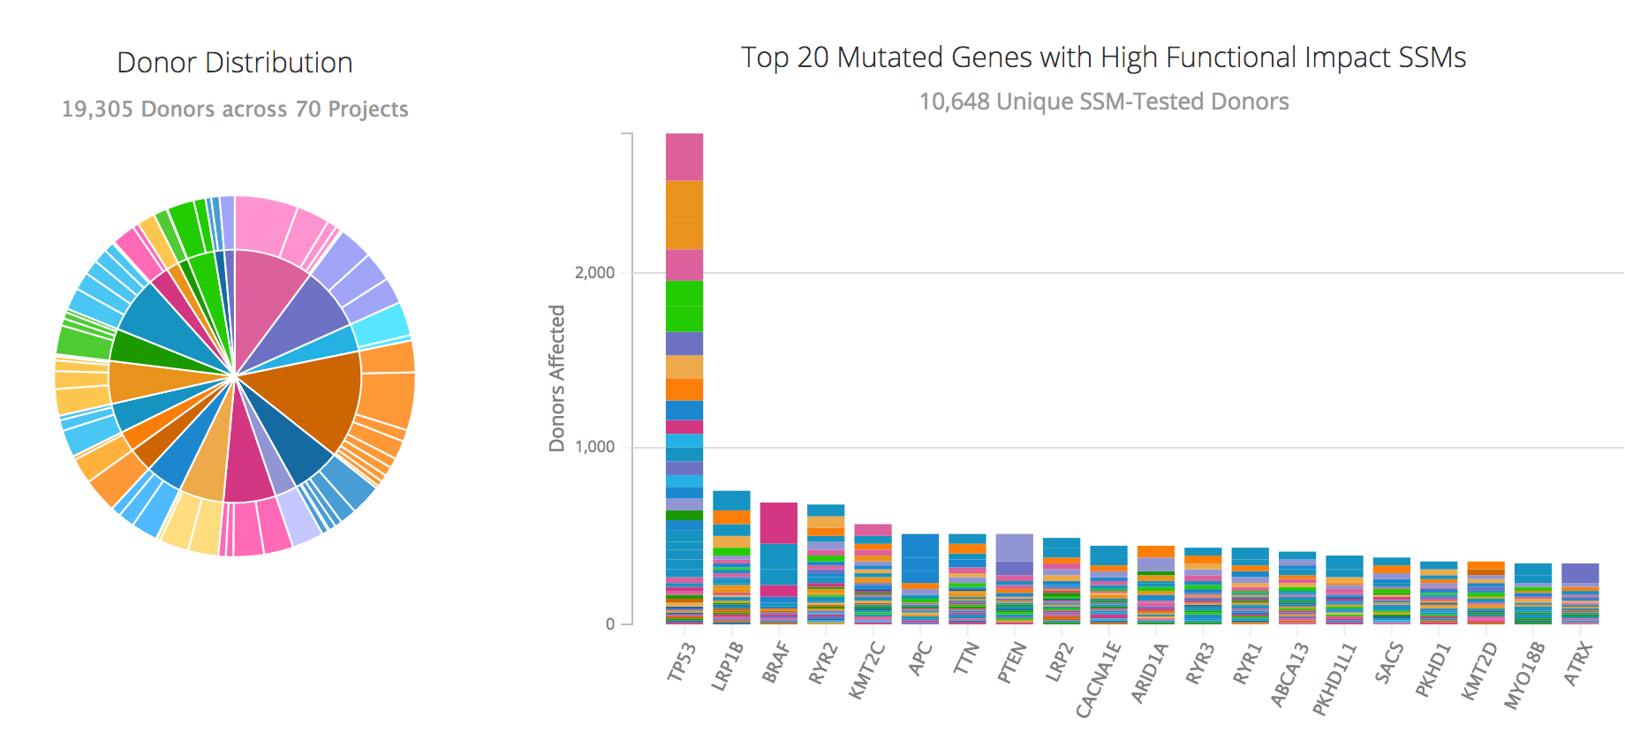
Cancer variation resources: TCGA and ICGC have sequenced 10,000s of exomes, 1,000s of whole genomes
https://dcc.icgc.org/

Slide 32
Exploring cancer mutation data portals
Many, many resources
Some of the resources that we find most useful
Genomic data commons
ICGC data portal
cBioPortal (OncoPrinter & MutationMapper)
Cosmic
TCGA data portal
St. Jude pediatric cancer portal (ProteinPaint)
We track (blog about) these resources as they develop (on BioStars here).

Slide 33
Non-human variation resources
European Variation Archive (EVA)
Online Mendelian Inheritance in Animals (OMIA)
Species specific resources
FlyBase
Mouse Genome Informatics
Rat Genome Database
Zebrafish Information Network

Slide 34
Deleterious vs. tolerated (functional vs. non-functional)
Many tools/resources attempt to classify variants as “deleterious” vs. “tolerated” (aka “benign”)
E.g. Sift, PolyPhen, Condel, CADD, etc.
The goal of these tools is often confused with predicting whether the mutation is gain-of-function/activating
Not the same thing…
Mostly driven by sequence conservation (though CADD considers a more complex set of features)
Variant effect annotators
VEP, snpEff, ANNOVAR, VAAST

Slide 35
A ‘waterfall’ plot is one way to visualize the pattern of recurrence in a cohort
https://github.com/griffithlab/GenVisR

Slide 36
Functional relevance to cancer biology?
Many useful resources that are gene centric
Databases of tumor suppressors and oncogenes
If the gene where a variant occurs is relevant to a disease or phenotype, then we turn our attention to the significance of the specific variant
Does the variant have established functional relevance?
DoCM – the Database of Curated Mutations is a resource that aggregates specific variants with documented relevance to cancer
Cancer Hotspots
Others

Slide 37
Clinically relevant?
A gene or variant can be relevant to disease biology or a specific phenotype but not have any established clinical relevance
Arguably this is mostly the case…
The majority of genes and variants when observed do not lead to a clinical action
Types of clinical relevance
Predictive (“druggable”)
Prognostic
Diagnostic
Predisposing

Slide 38
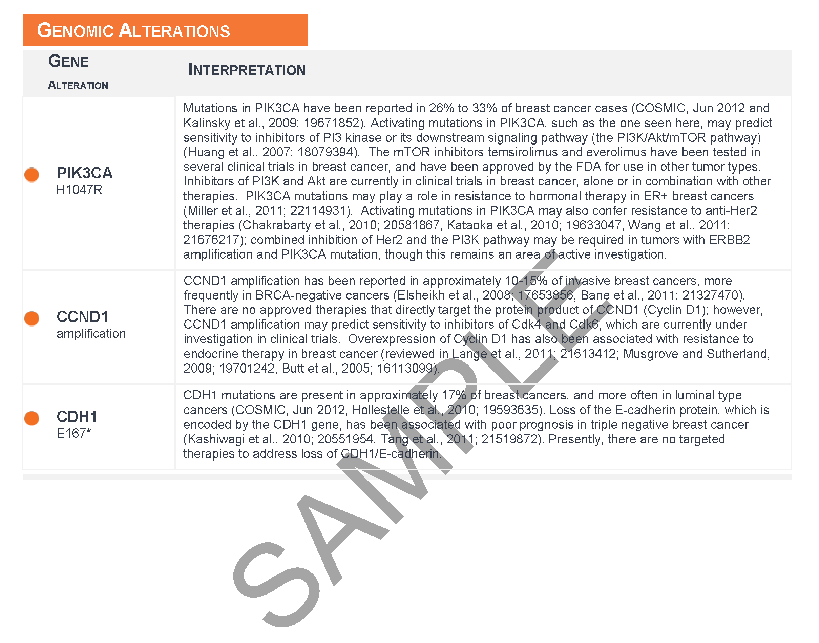
Providing current and comprehensive interpretations of clinical significance of variants is a non-trivial task
Interpretations are typically produced by paid curators with no provenance and no mechanism for feedback
This effort would be enhanced by a public domain effort
Notes:
We have this problem that providing current and comprehensive interpretations of the clinical significance of variants is at present a non-trivial and labor intensive task
Furthermore, many centers are currently duplicating each others efforts. Many interpretations are currently being produced by paid curators with no provenance and no mechanism for feedback.
In the next several slides I will argue that this effort would be better placed in the public domain where duplication of efforts can be reduced.
Creating tools and resources that help to address this critical bottleneck is a major focus of my group.
To make it a bit more concrete, we want to be able to get from raw events from genomics pipelines to a clinical report like this sample report from foundation one.
A clinician can not realistically be expected to open IGV, to pour over a circos plot, or mine through multi-tab spreadsheets or 100-slide presentations.
To interact with the clinician we need to get from 100s of raw candidates to the handful that are the most critical and a concise, up-to-date summary of the clinical significance of each of them.
- The example report above was obtained from the Foundation One website: http://foundationone.com/docs/FoundationOne_how-to-read-the-report.pdf

Slide 39
Resources to help interpret clinical relevance
Ainscough et al. 2016. Nature Methods

Slide 40
Resources providing clinical interpretations of mutations are the most lacking
ClinVar
ClinGen
LOVD
CIViC (cancer specific)
Many ad hoc “databases” at academic centers and hospitals
Commercial software solutions, pharmaceutical companies, etc.
Notes:
So we have a resource that describes the druggability of each human gene and another that aggregates the mutations that are most important to disease.
But we are still missing the clinical interpretation of individual variants.
Resources that tackle this problem are the most underdeveloped
The three existing resources that are the most relevant are MyCancerGenome, MD Andersons’ Personalized Cancer Therapy database and ClinVar.
There are also some ad hoc “databases” such as the Gene Drug Knowledge Database created by Rodrigo Dienstmann.
We have been keeping a close eye of each these but have found each to be lacking in some critical way.
MyCancerGenome and MD Anderson PCT both have a more closed model without a crowd sourcing capability. Neither has a publicly API. MyCancerGenome has a licensing agreement with GenomOncology.
ClinVar appears quite focused on inherited disease and the mechanism for contributing content seems cumbersome.
The Gene Drug Knowledge database is essentially a large spreadsheet. Difficult to maintain.
If there are other players in this area that I am missing I would be most interested in hearing about them!
Of course there are many, many cancer centers that are building their own internal databases of clinically actionable variants and some companies offering such databases as a service to these centers.

Slide 41
CIViC was created to fill gaps in these resources
www.civicdb.org
Information on the clinical impact of many cancer variants is scattered throughout the published literature
This makes collecting that information both time and labor-intensive
Yet we are all repeating each others efforts…
CIViC could act as a centralized forum for curation, interpretation, and debate
Existing resources do not facilitate computational access
No APIs, not open source, not open access, etc.
Goal: facilitate automated report generation on clinical variants
Notes:
We created CIViC to fill some of the gaps that we perceived in these resources.
Just like everyone else, we are faced with the challenge that the clinical relevance of variants is scattered throughout the published literature.
It is extremely time consuming and labor intensive to gather this information and make it fit into a formal data model
And yet, we are all repeating each others efforts in this regard
Our hope is that CIViC could act as a centralized forum for the curation, interpretation and debate over the clinical relevance of specific variants in cancer.
Furthermore, despite many parallel efforts, the existing resources that we are aware of do not facilitate computational access. They have no APIs, the web resources and database schemas are not open source, and the content is not open access.
These limitations are not compatible with automated report generation.

Slide 42
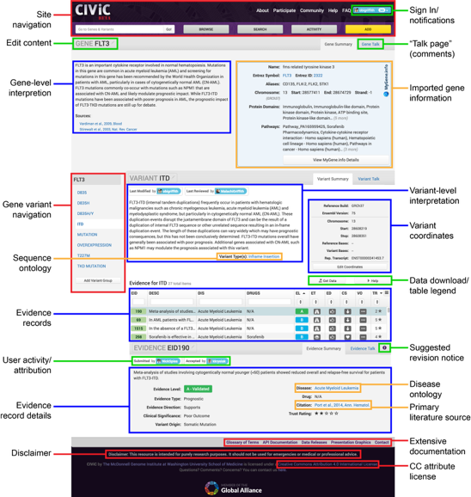
Features of CIViC
Browse evidence records for variant-drug-disease relationships as well as diagnostic and prognostic biomarkers
Curation/crowdsourcing interface
Expert review
Structured data model
Use of existing ontologies
JSON API to automate report generation
Notes:
Each page of the CIViC-beta application (www.civicdb.org) contains a navigation bar (A) with links to Gene/Variant Search, Activity, and Browse functions as well as links to learning materials. A gene summary page is shown here for BRAF. Exploring the site is unrestricted. However, if you sign in (B) then edit buttons (C) are activated that allow changes to be proposed at the gene, variant, or individual evidence level. Revision and comment history can be reviewed and further discussed on the “Talk pages” (D) linked to from gene, variant and evidence statements. A gene-level interpretation (E) is expert curated for each gene in CIViC while basic gene info (F) are automatically imported from Entrez Gene. Each gene has one or more variant (G) that when selected displays an expert-curated, variant-level interpretation (H) and representative transcript coordinates (I). Each variant must be supported by at least one structured evidence statement summarized in an evidence table (K). A table legend (J) explains the abbreviations and symbols used in this table. Recent user activity (L) is shown at the gene, variant and evidence statement levels. If an individual evidence statement is selected, the details and link to source for that statement are shown (M).

